Slide 1
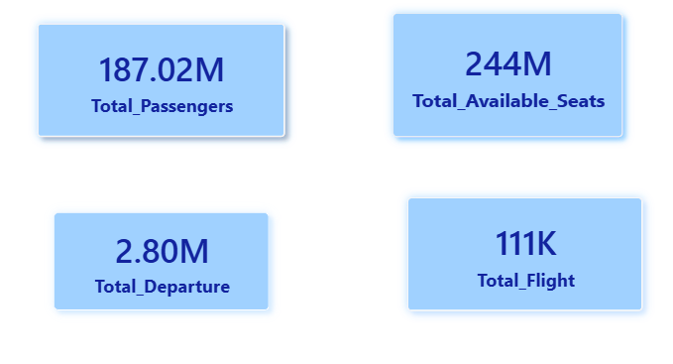
Airline High Cloud Analysis
Observations-
Total Passengers = 187.02M
Total Available Seats = 244M → ~57M seats remain unfilled.
Total Flights: 111K
Total Departures: 2.80M
Insights:
Departures are significantly higher than flights
(indicating multiple segments or legs per journey)

Slide 2
KPI 1- Date field
We have extracted below fields:
Year (for annual summaries)
Quarter ( Seasonal Analysis)
Month Name
Weekday name
Weekday No.
Type Of Day (Operational Insights)
Observations
1. Seasonality - Passenger traffic peaks in holiday months (e.g., December, summer vacation).
2.Operational Trends - Delays may cluster on certain weekdays (e.g., Mondays due to business travel congestion)
3 Growth - Year-over-year comparison highlights growth in passenger count or revenue
Insights
Management can plan dynamic pricing and capacity allocation to maximize profit during high-demand periods and reduce losses in low-demand months.
If delays cluster on Mondays, it may indicate airport congestion or crew scheduling issues. Airlines can adjust staffing or flight slots to improve punctuality.

Slide 3
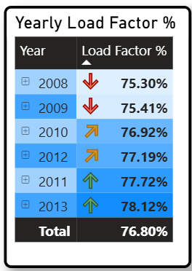
KPI-2 –Yearly , Monthly and Quartey Load factor %
Yearly / Monthly and Quarterly Load Factor - Observation:
Load factor tends to rise year-over-year if demand grows faster than capacity.
Some years show dips due to external shocks (economic downturns, pandemics, fuel price hikes).
Q2 and Q4 often show higher load factors due to summer holidays and year-end travel.
Q1 may show lower load factors (post-holiday slump).
Peak months (December, June, July) show high load factors due to leisure travel.
Insights:
Airlines can adjust seasonal pricing strategies — e.g., premium pricing in Q2/Q4, discounts in Q1.
Quarterly analysis helps in crew scheduling, maintenance planning, and marketing campaigns.
Airlines can run targeted promotions in low-demand months and maximize revenue in peak months with dynamic pricing.

Slide 4
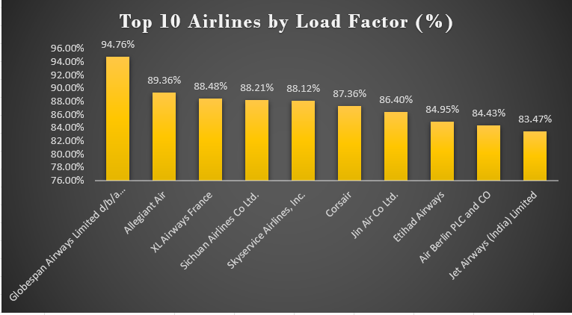
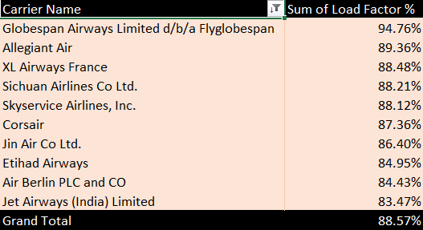
KPI-3 – Load Factor % by Carrier
Objective:
To analyze airline performance using Load Factor % (Load Factor = Transported Passengers / Available Seats)
Key Insights:
Highest Load Factor: Globespan Airways – 94.76% (Best seat utilization)
Top Performing Carriers:
Allegiant Air – 89.36%
XL Airways France – 88.48%
Sichuan Airlines – 88.21%
Lowest Among Top 10:
Jet Airways (India) – 83.47%
Overall Average (Grand Total): 88.57%
Interpretation:
Most carriers operate above 85% load factor, indicating strong demand and efficient capacity utilization
Higher load factor = better revenue efficiency
Globespan significantly outperforms peers → potential benchmark

Slide 5
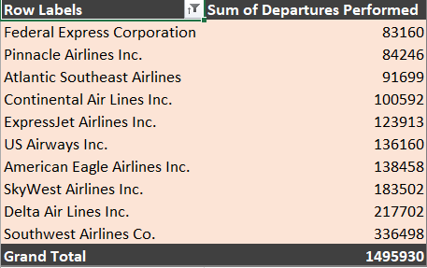
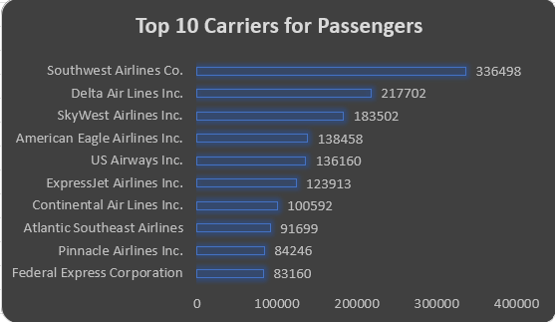
KPI-4 TOP 10 CARRIERS BASED ON PASSENGER PREFERENCE
Objective:
To identify the Top 10 Carrier Names based on Passenger Preference using the metric
Key Insights:
Analysis Type: Ranking / Top 10 Carriers
Southwest Airlines Co. is the highest preferred carrier with 336,498 departures
Delta Air Lines Inc. is second with 217,702 departures
Top 3 carriers contribute a major share:
Southwest
Delta
SkyWest
📌 These airlines show higher operational presence and likely higher passenger preference.
Approach Used:
Extract carrier-level flight data
Group by Carrier Name
Calculate Sum of Departures Performed
Sort in Descending Order
Select Top 10 Carriers
Interpretation:
Based on the Sum of Departures Performed, the most preferred airline is:
🏆 Southwest Airlines Co. (336,498 departures)
The Top 10 carriers together performed 1,495,930 departures, indicating strong market dominance.

Slide 6
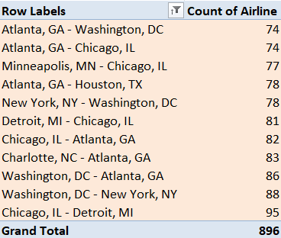
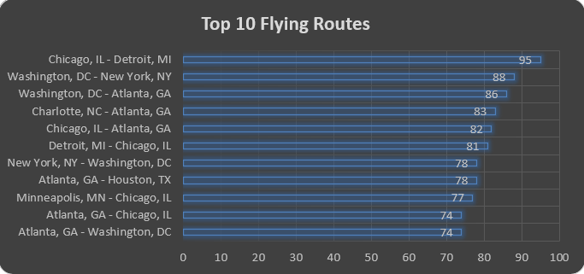
KPI 5 TOP 10 ROUTES BY NUMBER OF FLIGHTS
OBJECTIVE: To Identify The Top 10 Routes Based On Number Of Flights Using
The Metric. Count Of Flights (Airline Count).
KEY INSIGHTS :
Analysis Type: Ranking / Top 10 Routes
Chicago, Il → Detroit, Mi Is The Busiest Route With 95 Flights
Washington, Dc → New York, Ny Is Second With 88 Flights
Washington, Dc → Atlanta, Ga Ranks Third With 86 Flights
APPROACH USED:
Extract Route-level Flight Data
Create Route Using Source → Destination
Calculate Count Of Flights
Sort Data In Descending Order
Select Top 10 Routes
INTERPRETATION:
Based On The Count Of Flights, The Busiest Route Is: 🏆 Chicago → Detroit (95 Flights)
The Top 10 Routes Together Contribute 896 Flights, Indicating High Air Traffic
Concentration Across Key City Routes.

Slide 7
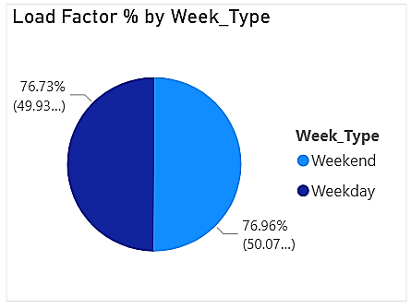
KPI 6- load factor on Weekend vs Weekdays.
Observation-
Load Factor Is Almost Evenly Split:
Weekend: 76.73%
Weekday: 76.96%
The Difference Between Weekend And Weekday
Performance Is Very Minimal (0.23%).
Insights-
1.Balanced Demand Pattern-airlines Are Experiencing
Consistent Occupancy Throughout The Week.
2. Offer Weekday Discounts To Shift Flexible Travelers.
3. Operational Planning Is Already Efficient,
But Fine-tuning Can Increase Profitability.
4. Airlines Can Introduce:
Premium pricing on peak weekday business hours.

Slide 8
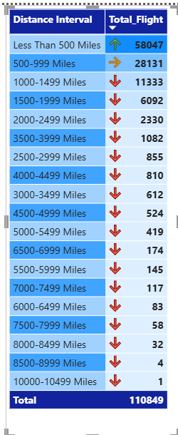
KPI 7-number of flights based on Distance group
Observation
Dominance Of Short-distance Flights
< 500 Miles: 58,047 Flights (Highest)
500–999 Miles: 28,131 Flights
These Two Categories Alone Make Up The Majority Of
Total Flights (~78%).
Sharp Decline After 1000 Miles
1000–1499 Miles: 11,333 Flights
Total Flights = 110,849
Insights
Significant Drop As Distance Increases.
Indicates Strong Operational Scale But Skewed Toward Short Routes
Airlines May Be Prioritizing Volume Over Margin.
Airlines Are Heavily Focused On Short-haul Routes

Slide 9
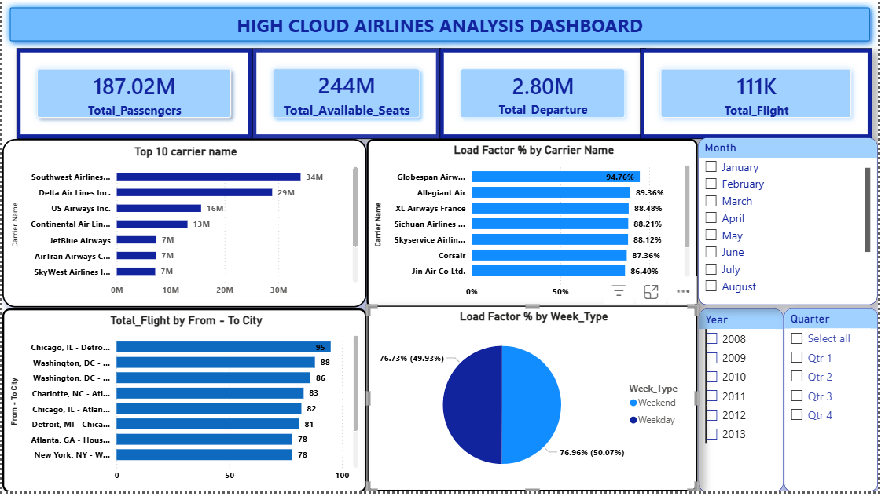

Slide 10
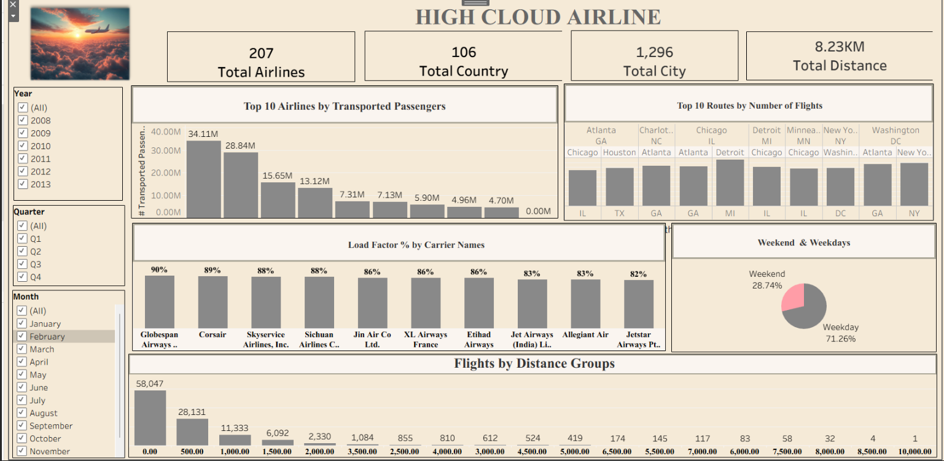

Slide 11
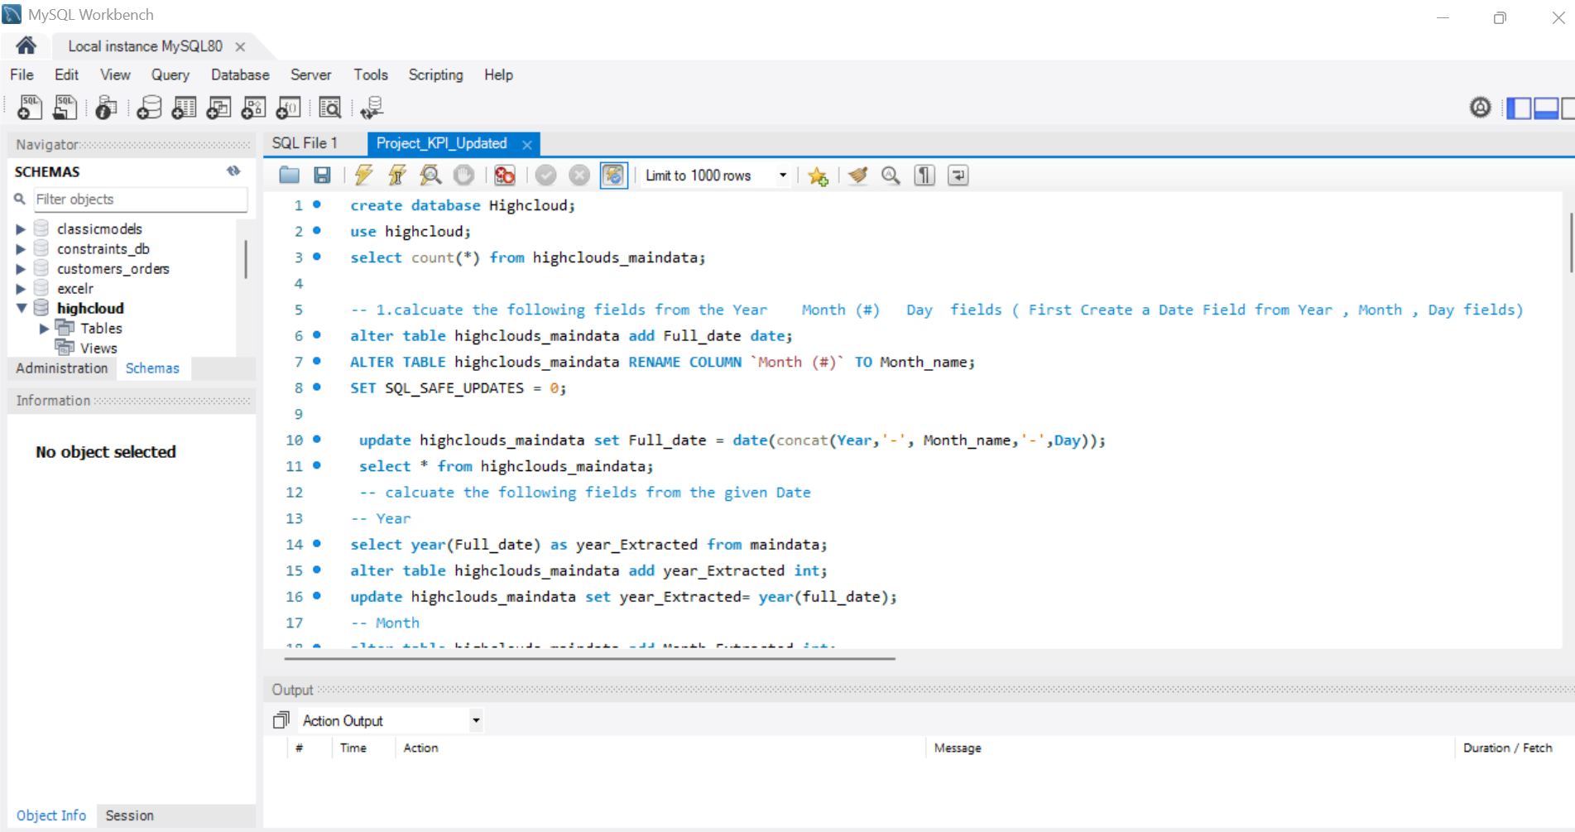
SQL Query

Slide 12
Summary
Underutilization Of Airline Capacity
Total Passengers = 187.02M And Total Available Seats = 244M → ~57M Seats Remain Unfilled.
Declining Load Factor In Early Years
2008–2009 Shows Lower Load Factors (~75%) And
Gradual Improvement Reaching 78.12% In 2013
Imbalance In Flight Distribution By Distance
Flights <500 Miles = 58,047 (Very High) And Flights >3000 Miles = Significantly Low
Uneven Performance Across Airlines
Top Passengers: Southwest & Delta And Highest Load Factor: Globespan Airways (~94.76%)
Route Concentration Risk
Few Routes Dominate (E.G., Chicago–Detroit, Washington–Boston)
Low Load Factor Variability Across Airlines
Load Factors Range From ~86% To ~95%, With Globespan Airways (~94.76%) Being The Highest.
Weekend Vs Weekday Load Factor Balance
Load Factor Is Almost Evenly Split:
Weekend: ~50.07% And Weekday: ~49.93%

Slide 13
Conclusion & Solution
1. Airlines Reduce The Gap Between Available Seats And Actual Passengers - Offer Last-minute Deals & Loyalty Rewards For Unsold Inventory
-Implement Dynamic Pricing Models To Fill Empty Seats
2. Airlines Can Maintain Continuous Improvement By Follow This
- Introduce Seasonal Pricing Strategies
- Analyze External Factors (Economic Downturn, Fuel Prices)
3. Airlines Can Balance Short-haul And Long-haul Operations For Better Profitability.
- Increase Long-haul Route Investment Where Demand Exists.
- Optimize Short-haul Routes Using Smaller Aircraft
-Introduce Hub-and-spoke Model To Connect Long-distance Travel
4. Airlines Can Achieve Higher Efficiency Despite Lower Passenger Volumes
- Study High Load Factor Carriers’ Scheduling Efficiency
-Improve Route Optimization And Turnaround Time
- Focus On High-demand Niche Markets Instead Of Volume Alone

Slide 14
5. Airlines Can Reduce Dependency On A Limited Number Of High-traffic Routes.
-Monitor Route Profitability Continuously.
-Diversify Into Emerging And Underserved Routes.
-Use Data-driven Route Expansion Strategies.
6. Airlines Can Better Balance Demand Between Weekdays And Weekends.
Introduce Weekday Discounts For Leisure Travellers
Adjust Flight Schedules To Align With Peak Demand Times.
7. Airlines Can Optimize Route Networks To Maximize Flight Utilization?
Increase Frequency On High-demand Routes
Reduce Or Restructure Low-demand Routes.
Use Hub-and-spoke Models To Consolidate Passengers Efficiently
Implement Dynamic Seat Allocation And Promotions During Low-demand Periods.

